Slide 1
Kubernetes

Slide 2
CONTENTS
Introduction to Kubernetes
Core Components
01
02
Resources
03

Slide 3
01
Introduction to Kubernetes

Slide 4
Overview
History and Evolution
Definition and Purpose
Kubernetes was originally designed by Google, but the project is now maintained by a worldwide community of contributors, and the trademark is held by the Cloud Native Computing Foundation.
Kubernetes is an open-source platform that automates the management, scaling, and deployment of containerized applications. It's also known as "k8s".
PART 02

Slide 5
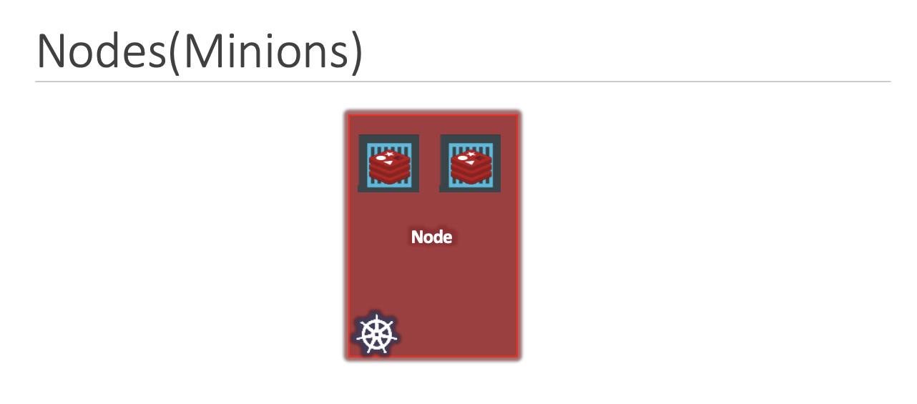
Key Terms And Definitions
Nodes
A node is a machine – physical or virtual – on which kubernetes is installed. It is a worker machine, and this is where containers will be launched by kubernetes.

Slide 6
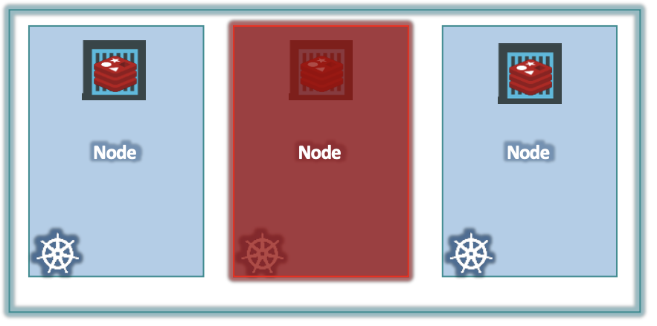
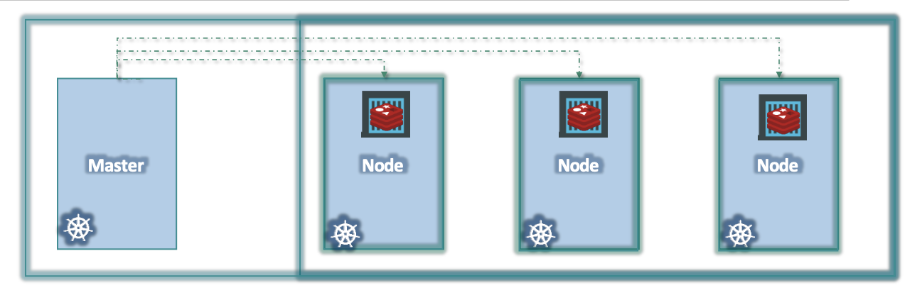
Cluster
A cluster is a set of nodes grouped together. This way even if one node fails you have your application still accessible from the other nodes. Moreover, having multiple nodes helps in sharing load as well.
Master Node
Each cluster has a Master Node which is responsible for -> Managing the cluster -> Moving workload of failed node to another worker node ->Monitor the Nodes and stores the information of members of the cluster

Slide 7
Core Components

Slide 8
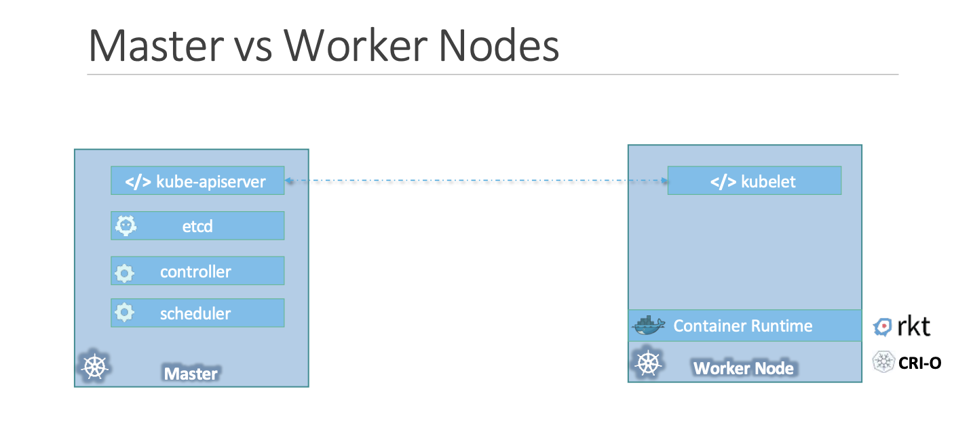
Type here...

Slide 9
Master Node Components
API Server
Scheduler
Etc
The API Server is the central management entity that exposes the Kubernetes API. It acts as the front- end for the Kubernetes control plane.
Scheduler is responsible for distributing work or containers across multiple nodes. It looks for newly created containers and assigns them to Nodes.
ETCD is a distributed reliable key-value store used by kubernetes to store all data used to manage the cluster.
Controller
The controllers are the brain behind orchestration. They are responsible for noticing and responding when nodes, containers or endpoints goes down. The controllers makes decisions to bring up new containers in such cases.

Slide 10
Worker Node Components
Kubelet
Container Runtime
kubelet is the agent that runs on each node in the cluster. The agent is responsible for making sure that the containers are running on the nodes as expected.
The Container Runtime is the software that runs containers. Kubernetes supports several runtimes, including Docker, containerd, and CRI- O.

Slide 11
Resources
Pod
Replica Set
Deployment
Services

Slide 12
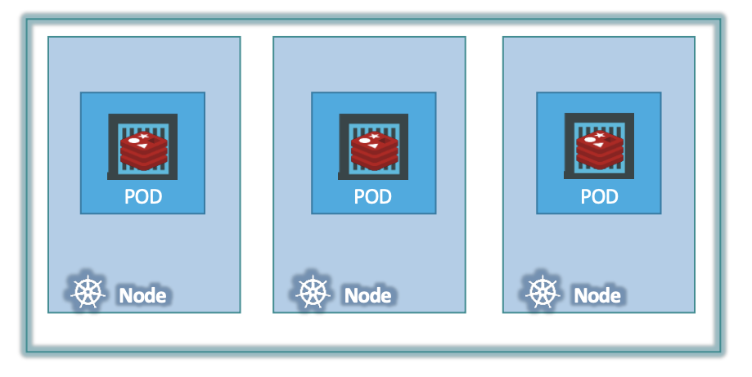
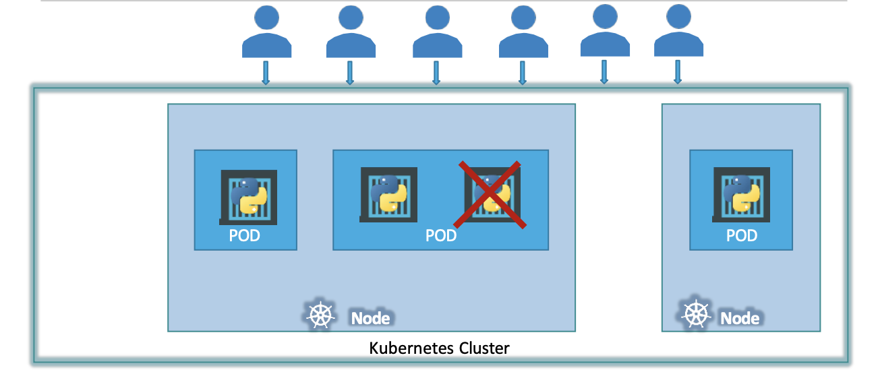
Pod
Pods are the smallest deployable units in Kubernetes, which can host one or more containers. If you want to scale your application its better to spin up new pods instead of creating pods with multiple container of same kind.

Slide 13
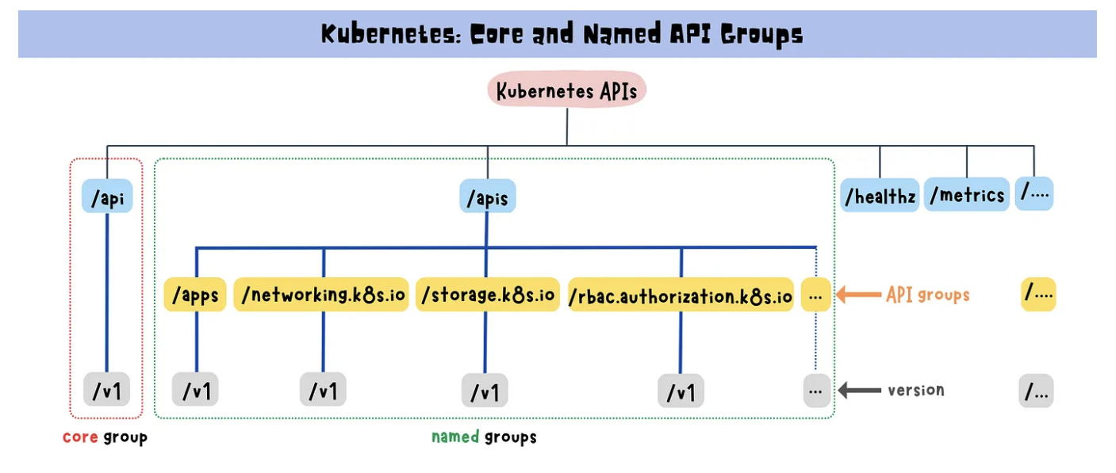
ApiVersion : Depends on resource you are creating so for resources under core API groups use v1 and for resources under Apps api group use apps/v1. you can also run kubectl api-resources to check which api version will be used for which resource
Pod Yaml
Metadata : Name -> specifies the name of the resource you create. Labels -> are used to efficiently select resources based on attributes.

Slide 14
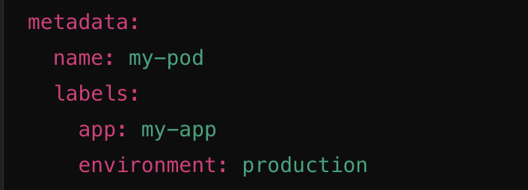
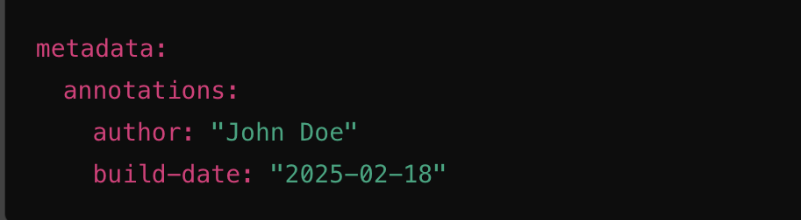
Kind : Name of the resource that you want to create
Metadata : Name -> specifies the name of the resource you create. Labels -> are used to efficiently select resources based on attributes. Used in spec command to specify how to select resources.
Annotations -> They are key-value metadata attached to objects like Pods, Deployments, Services, etc. They provide non-identifying information to kubernetes resources
yaml

Slide 15
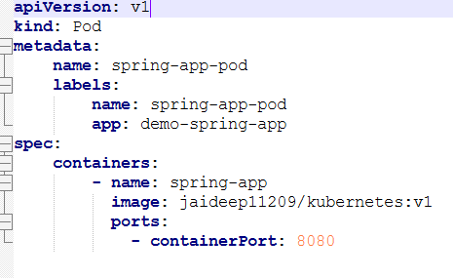
Pod.yaml
Container Port:
This specifies the port at which the application listens inside the container.

Slide 16
Replica Set

Slide 17
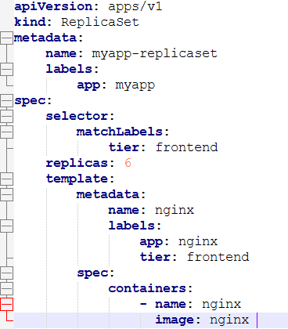
Replica Set:
A ReplicaSet ensures that a specified number of pod replicas are running at any given time. If a pod fails or is deleted, the ReplicaSet automatically creates a new one to maintain the desired state

Slide 18
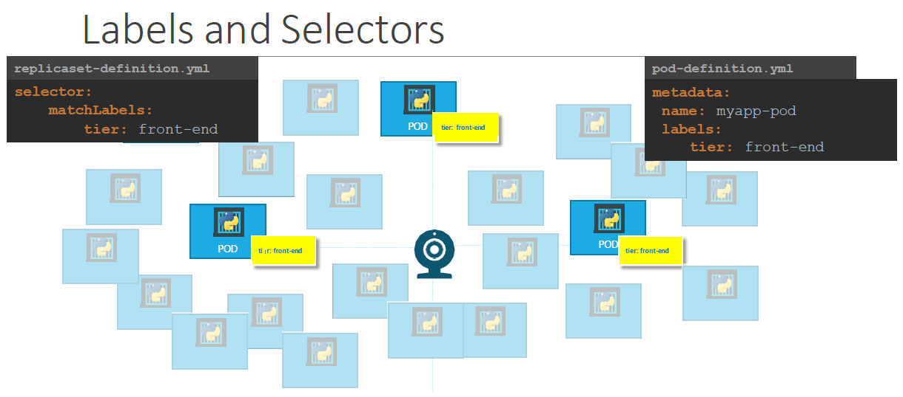

Slide 19
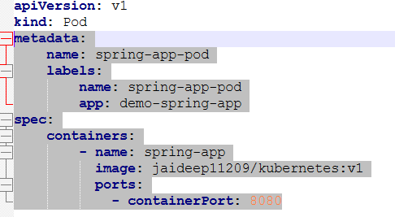
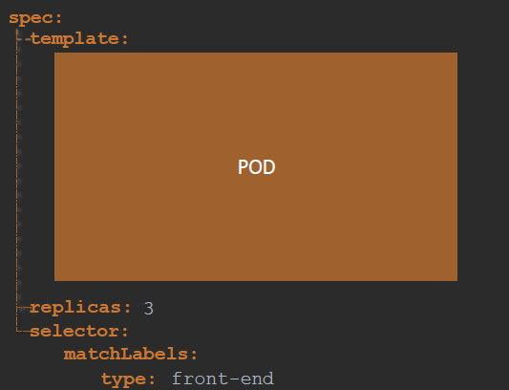
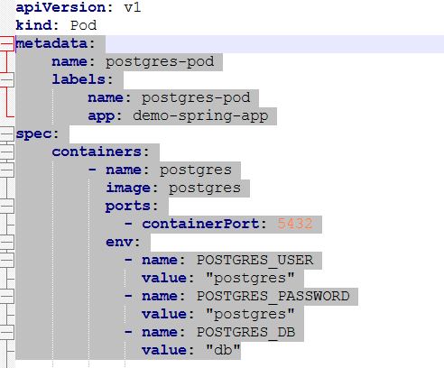
If scaling needed

Slide 20
Deployments

Slide 21
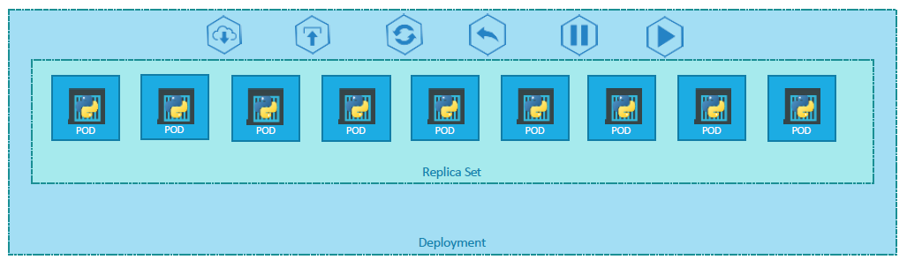
Deployment:
2 Types of Deployment:
Rolling Update (Default)
Recreate
Kubernetes Deployments are used to manage the deployment and scaling of containerized applications.

Slide 22
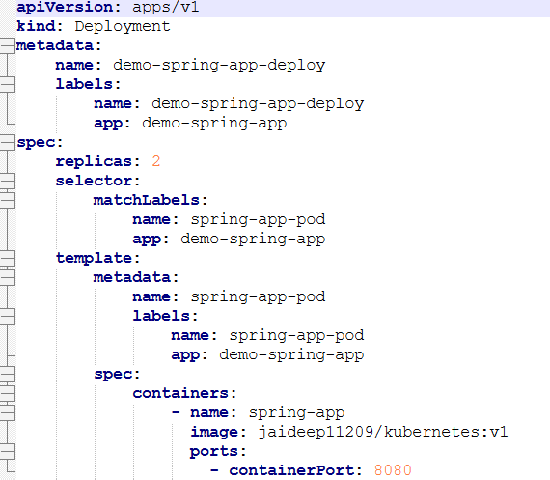
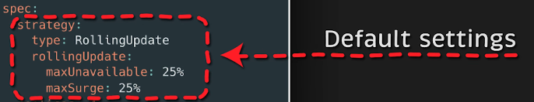
Rolling Update :
maxUnavailable -> states at any given time how many pods can de down(max).
maxSurge -> states how many more pods could be created.
Advantage: Zero Downtime
Disadvantage: Longer deployment time.
Values can be provided either in percent format or number format.

Slide 23

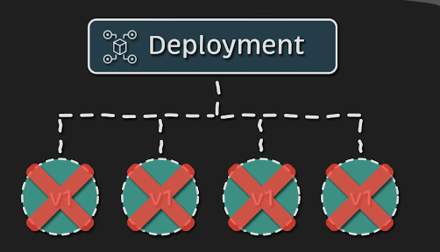
Recreate :
The Recreate strategy involves shutting down all the existing instances of the application before starting up the new ones.
Advantage: Ensures only one version running at a time.
Disadvantage: There will be downtime and service disruption.

Slide 24
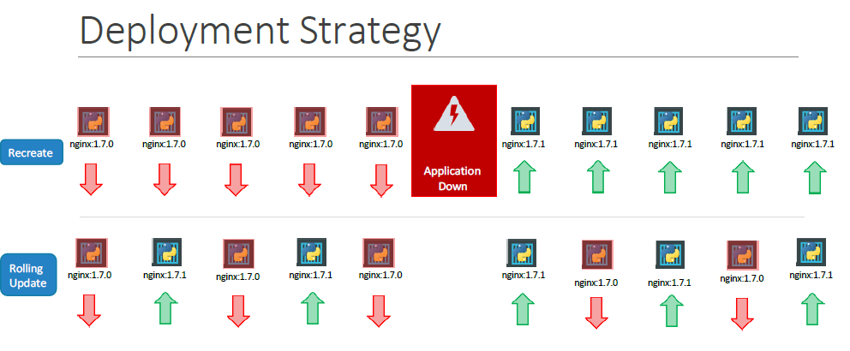

Slide 25
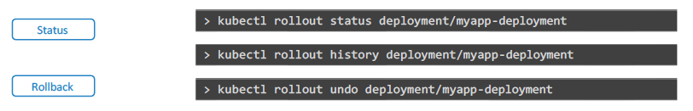
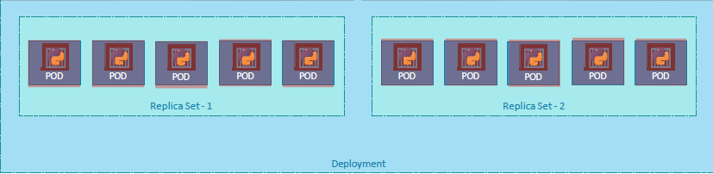
Rollout and Versioning
Whenever you create a new deployment or upgrade the images in an existing deployment it triggers a Rollout. A rollout is the process of gradually deploying or upgrading your application containers

Slide 26
Services

Slide 27
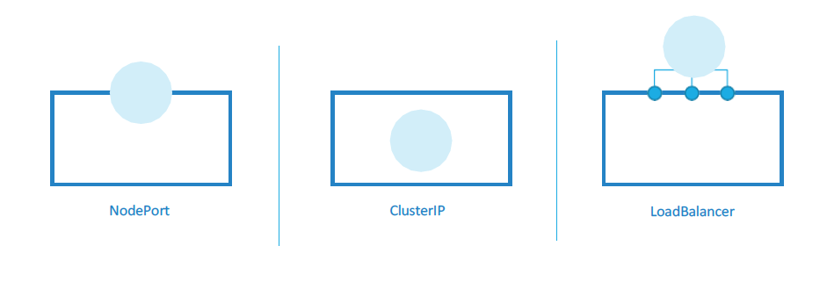
Service
Types of Services :
Kubernetes Services enable communication between various components within and outside of the application .
Default

Slide 28
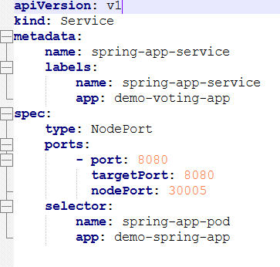
NodePort
NodePort is a type of Kubernetes service that exposes an application running in a cluster on a specific port of each node's IP address. This allows external traffic to access the application using the node's IP address and the designated port number.
Nodeport-> Port exposed on the node where external traffic comes. can be in the range of 30000-32767. If default is not provided a free port is selected. Port -> Intermediary port where both NodePort and TargetPort forward traffic. It is the only mandatory port rest both can have defaults.
TargetPort -> Port in POD where traffic gets forwarded to by default is the same as container exposed port.

Slide 29
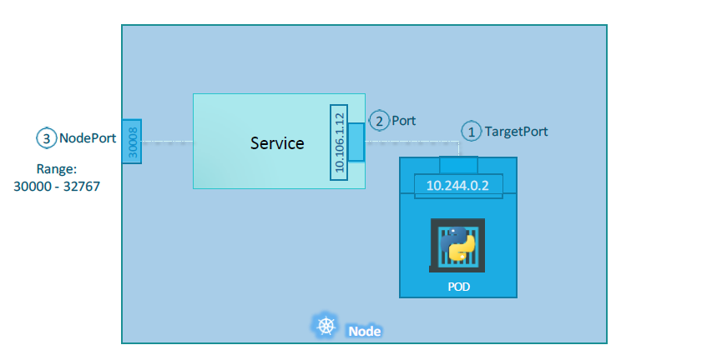

Slide 30
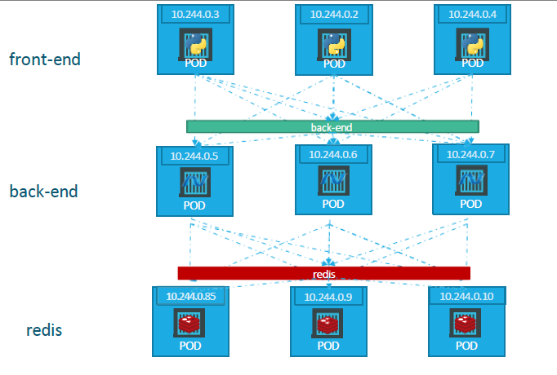
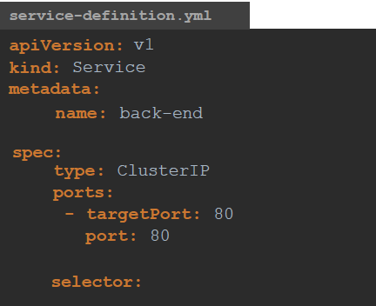
Cluster IP
NodePort
A Cluster IP is a type of internal IP address used within a Kubernetes cluster. It is assigned to a service, making the service accessible only within the cluster. This IP is used to route traffic to the appropriate pods that are part of the service.
Front-end

Slide 31
Load Balancer
A LoadBalancer in Kubernetes is a type of service that exposes balanced traffic towards application.
Challenges of Using LoadBalancer Service Locally
Lack of Built-in Load Balancer
Cloud Providers -> Cloud providers like AWS, GCP, and Azure offer built-in load balancers that integrate seamlessly with Kubernetes. When you create a LoadBalancer service, Kubernetes automatically provisions and configures the load balancer using the cloud provider's infrastructure.
Local Environments -> In a local environment, there is no built-in load balancer available. This makes it challenging to replicate the behavior of a cloud-based load balancer.

Slide 32
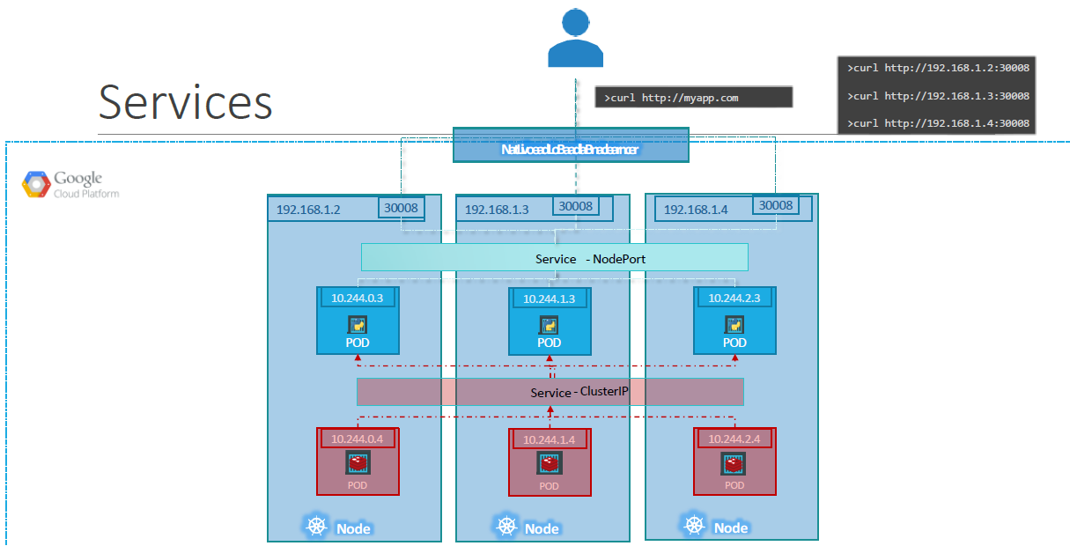

Slide 33
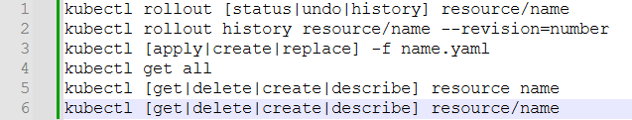
Important Commands

